Slide 1
Heart Disease Diagnosis
Samir Atpadkar
(UNID: UM20230834)

Slide 2
Agenda
Introduction​
Significance
KPI
Dashboard
Insight ​And Analysis

Slide 3
Introduction
"The Heart Disease Diagnosis Project is a comprehensive analysis aiming to uncover insights and patterns in cardiovascular health. Utilizing a dataset comprising various clinical parameters, including age, gender, cholesterol levels, exercise-induced heart rate, and other health metrics, this project aims to predict the presence or absence of heart disease. By employing machine learning algorithms and statistical analysis, the project endeavors to understand the correlations between different health indicators and heart disease.
Overview of the dataset and its attributes.
Exploratory Data Analysis (EDA) findings highlighting trends and correlations.
Feature engineering or selection strategies employed.
Description of machine learning models used for prediction.
Performance metrics of the predictive models.
Insights derived and recommendations for heart disease risk assessment..

Slide 4
Significance
The heart disease dataset comprises vital health metrics like blood pressure, cholesterol, and heart rate, enabling predictive modeling and insights into cardiovascular health. Its significance lies in aiding diagnosis, predictive analysis, informing healthcare decisions, and driving research to enhance heart disease prevention and treatment strategies.

Slide 5
Main KPIs:
Average age of Patients
Total Number of Patients
Positive Patients
Average BP
Filters:
Gender Filter
Absence Disease Absent or Present Filter

Slide 6
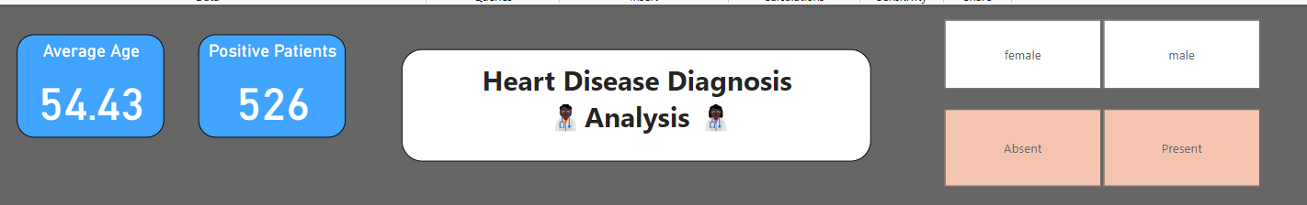
KPI’s And Filters

Slide 7
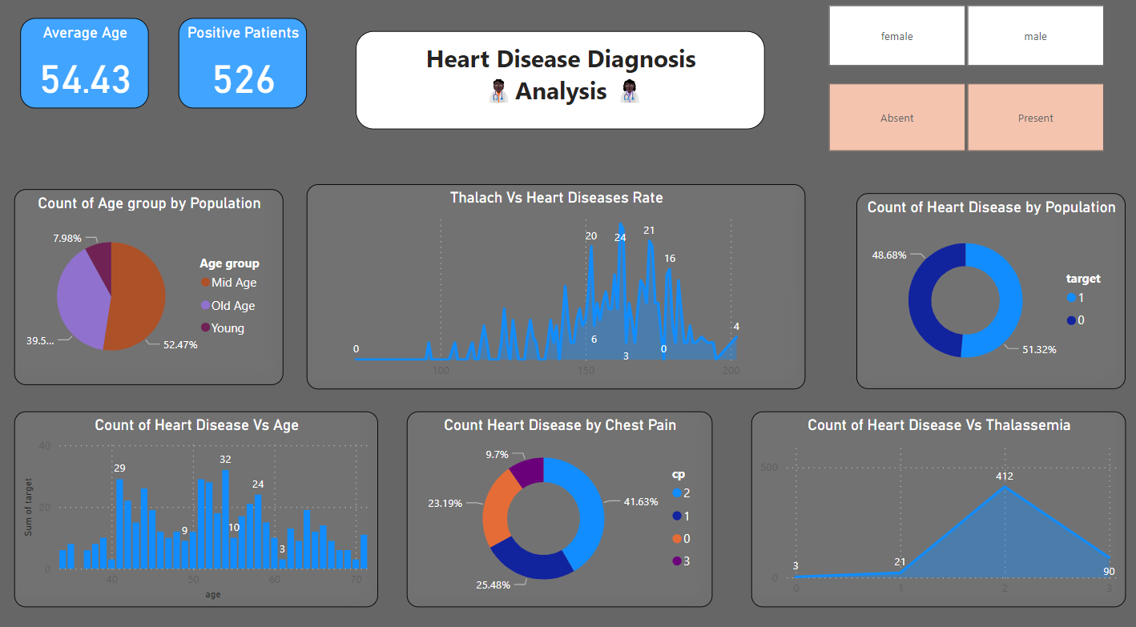
Dashboard Overview

Slide 8
Insight and analysis
Age: Patients within the age range of 50 to 60 exhibit a higher likelihood of having heart disease compared to other age groups. This age bracket might indicate an increased susceptibility to heart-related conditions.
Chest Pain (cp): Patients experiencing chest pain types 2 (atypical angina) and 3 (non-anginal pain) demonstrate a notably higher incidence of heart disease compared to other types. This suggests a potential correlation between these types of chest pain and heart conditions.
Blood Pressure (trestbps): There might be an observable trend or relationship between blood pressure levels and heart disease risk. However, further analysis could elucidate specific blood pressure ranges correlating with higher incidences of heart disease.
Thalassemia (thal): Patients with type 2 thalassemia may have a higher prevalence among individuals diagnosed with heart disease. The presence of this specific type of thalassemia might be associated with an increased risk of heart-related conditions.
Cholesterol Levels (chol): Higher or specific ranges of cholesterol levels might exhibit a correlation with heart disease.

Slide 9
Conclusion
Key findings suggest heightened heart disease susceptibility among patients aged 50-60. Chest pain types 2 & 3 show significant correlation. Thalassemia type 2 might relate to increased heart disease prevalence. Blood pressure and cholesterol levels also hint at potential connections, urging further investigation. These insights emphasize age, specific chest pain types, and thalassemia as crucial indicators in assessing heart disease risk, guiding targeted interventions for better cardiovascular health.

Slide 10
THANK YOU
Samir Atpadkar
samatpadkar183@gmail.com

